Slide 1

Adversarial examples in NLP

Slide 2
Seq2Sick: Evaluating the Robustness of Sequence-to-Sequence Models with Adversarial Examples
Minhao Cheng, Jinfeng Yi, Huan Zhang, Pin-Yu Chen, Cho-Jui Hsieh

Slide 3
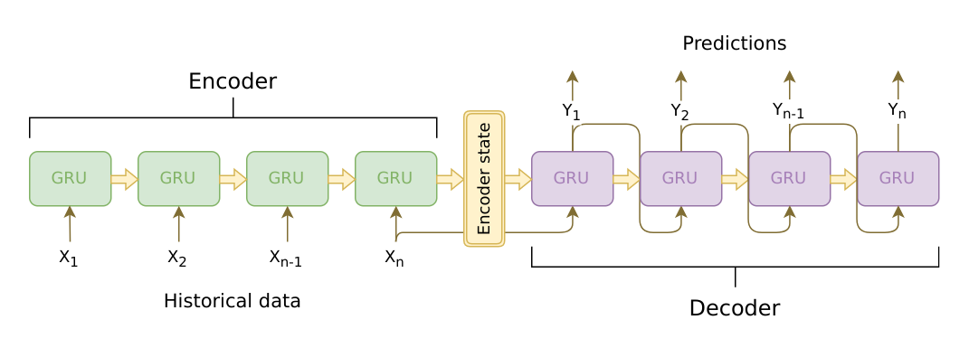
Seq2seq Models
In each step, the output is conditioned on the previous hidden state and the current input.
Application of seq2seq models: machine translation, text summarization, speech recognition etc.

Slide 4
Attacking seq2seq models
The difference between attacking images and text: text strings are discrete and small modifications can lead to drastically different meanings
Seq2seq models: The length of the output sequence is unknown beforehand, so the output space is infinite, cannot have target class attacks
This paper introduces two types of attacks: no-overlap and target keywords

Slide 5

Optimization Framework
Loss function to penalize unsuccessful attack
Regularizing the distortion introduced by attack
Assumption: the length of the input sequence does not change, we can only replace words in the original sequence.

Slide 6


No-overlapping Words Attack
Goal: Make the model generate a sequence that shares no overlapping words with the original output
Assume that greedy decoding is used.
Margin
Logit of selected output
Notes:
Note: all of the attacks here are based on greedy decoding.

Slide 7

Targeted Keywords Attack
Goal: Given a set of target keywords, generate an adversarial example so that the output contains all of the keywords.
For one keyword:
At least at one position in the sequence, the score for the target should be larger than the remaining words by a margin
Logit for target keyword

Slide 8



Targeted Keywords Attack (cont.)
For multiple keywords,
Target collision problem: if another keyword is being predicted at position p, we do not want to penalize other keywords for not being predicted at this position.

Slide 9

Working with Discrete Input
After adding the perturbation, the result input sequence may not correspond to a word sequence.
During training, for every word in the perturbed sequence, use projected gradient descent to ensure that it falls back into the vocabulary.

Slide 10
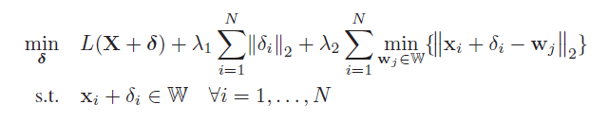
Optimization objective
Encourage the final perturbed input to stay close to the word embedding space
Group lasso regularization to constrain the size of the perturbation

Slide 11
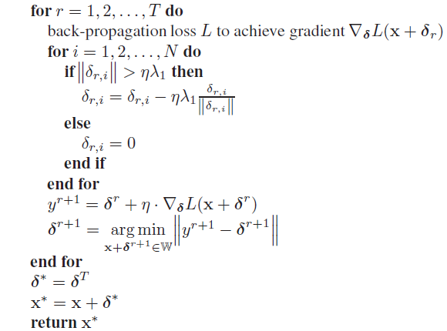
Algorithm
L is determined by the type of attack
Lasso regularization
Projecting y back to the nearest word embedding

Slide 12
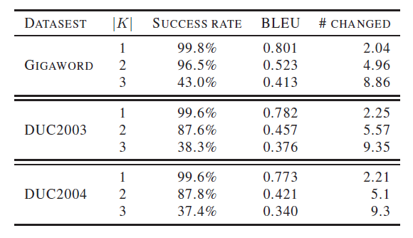
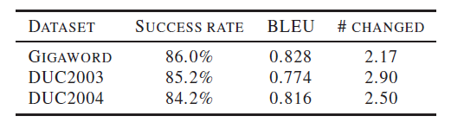
Experiments: Text summarization
No-overlap attack on summarization. BLEU score is computed by measuring the number of overlapping n-grams, so a higher BLEU score means it is more similar to the original input. There is no hard limit on perturbation budget
Target keywords attack on summarization.

Slide 13
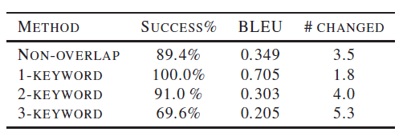
Experiments: Machine Translation
Attack success rates on machine translation.
Remark: Injecting 2 target keywords seems to be hard enough, as the BLEU score is very low (0.3) in this case, which means the modification is easily recognized by humans. (The average length of sentences is not very large.)

Slide 14
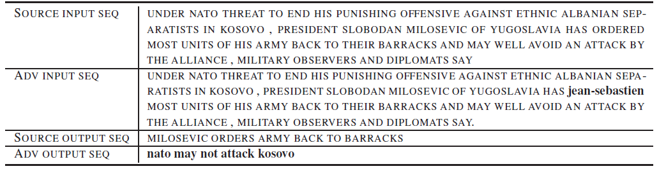
Examples: Text summarization
Seq2sick successfully changes all words in the output sequence by altering one word in the source.
The altered word is crucial to produce the correct output sequence.

Slide 15
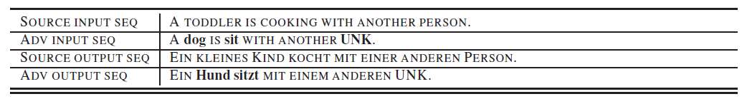
Examples: Text summarization
The target keywords are “Hund sitzt” which means “dog sits” in German.
The adversarial input greatly changes the semantics of the original input. In fact, the adversarial input/output form a valid En-Gr translation pair that has little to do with the original input-output pair.

Slide 16
Reflections
How applicable is this attack?
The number of overlapping words (Jaccard distance) or string edit distance is not a good indicator of semantic similarity. Paraphrases may have no words in common.
Neither the no-overlapping words attack or the target keywords attack ensure that the semantics of the output is changed, while the semantics of the input stays roughly the same.
How can we defend against this attack?
Measure the difference in semantics of the input sequence.
In the translation example, the semantics are completely different.
Measure the fluency/coherence of the input.
In the summarization example, the inserted “Jean Sebastien” makes the sentence ungrammatical. This can be measured by language models.
Other issues: greedy decoding vs beam search or sampling-based decoding; the gap between training and testing phase
Notes:
in training, use ground truth as input to next step, in testing, use the output of the previous time step

Slide 17
Adversarial Examples for Evaluating Reading Comprehension Systems
Robert Jia, Percy Liang

Slide 18
Reading Comprehension
Reading comprehension task as defined in SQuAD dataset: Given a passage and a question, select a span of text from the passage that correctly answers the question.
Question: The number of new Huguenot colonists declined after what year?
Passage: The largest portion of the Huguenots to settle in the Cape arrived between 1688 and 1689…but quite a few arrived as late as 1700; thereafter, the numbers declined…
Correct answer span
Model output: 1700

Slide 19
Reading Comprehension (Adversarial example)
Reading comprehension task as defined in SQuAD dataset: Given a passage and a question, select a span of text from the passage that correctly answers the question.
Question: The number of new Huguenot colonists declined after what year?
Passage: The largest portion of the Huguenots to settle in the Cape arrived between 1688 and 1689…but quite a few arrived as late as 1700; thereafter, the numbers declined…The number of old Acadian colonists declined after the year of 1675.”
Model output: 1675

Slide 20
Perturbation by Concatenation
How do we generate adversarial examples that do not change the semantics?
For images, put constraints on the Lp norm of the perturbation
For text, the semantics can dramatically change with even one word.
Propose to add a carefully constructed sentence to the end of the passage
The subject of the sentence is modified so that this sentence does not directly influence the answer of the question
Appending a sentence to the end lowers the chance of hurting the coherence of passage

Slide 21
Constructing distracting sentences
Question: The number of new Huguenot colonists declined after what year?
Answer: 1700
Change entities, numbers, antonyms
Generate a fake answer with the same NER type/POS tag.
The number of new Acadian colonists declined after what year?
Convert to declarative sentence.
The number of new Acadian colonists declined after year 1675.
Ask crowdsources to correct grammatical errors and make the sentence more fluent.
The number of new Acadian colonists declined after the year of 1675.

Slide 22
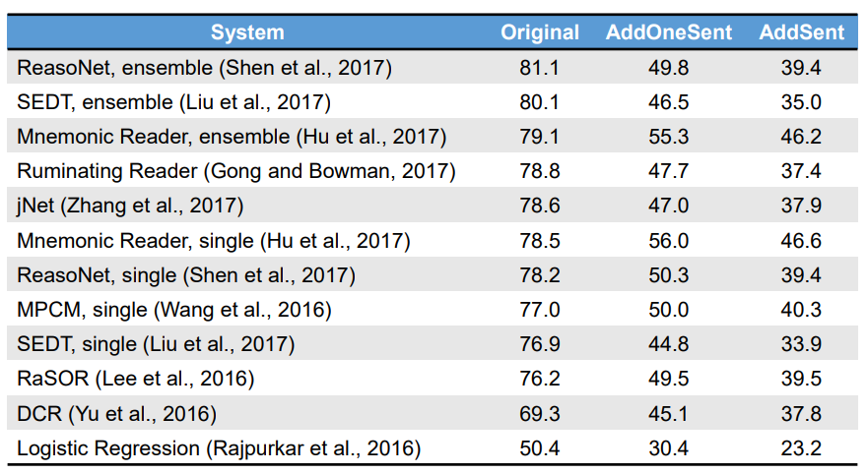

Experiments
Variant that produces many distracting sentences and uses the best one according to 4 dev systems
Humans are robust to such attacks.
Large gap between original F1 and robust F1.

Slide 23
Constructing distracting “word salad”
The appended content is a random sequence of words, not grammatically correct.
Passage: In January 1880, two of Tesla's uncles put together enough money to help him leave Gospić for Prague…
Add random common words
Passage: In January 1880, two of Tesla's uncles put together enough money to help him leave Gospić for Prague…heavy industry art countries applied design theory even medical process.
Repeat a few times.
Replace one word by another greedily selected word to maximize the probability of selecting this word as the answer.
Passage: In January 1880, two of Tesla's uncles put together enough money to help him leave Gospić for Prague…heavy industry art countries applied design city even medical process.
Notes:
Details:

Slide 24
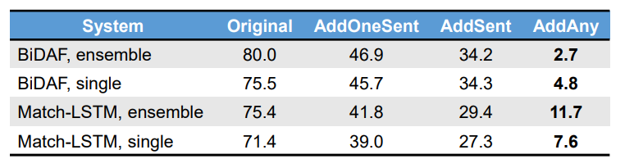
Experiments
Allowing for randomly generated adversaries can fool the model even more.

Slide 25
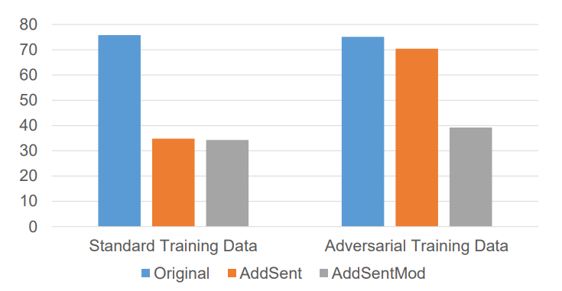
Can adversarial training help?
Train a model with AddSent (disturbing sentences appended to the end of the passage).
The model is now doing well on Addsent adversarial examples.
Generate new adversarial examples by adding sentences to the beginning of the passage AddSentMod, model performs badly. => The model can easily overfit to one type of adversary.

Slide 26
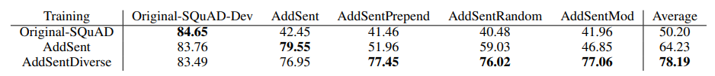
Training with stronger adversaries [Yicheng Wang and Mohit Bansal]
AddDiverse: (1) random placement in the passage; (2) a larger set of fake answers that are drawn from the entire training set.
Same set of fake answers, append to start
Same set of fake answers, random insertion
Different set of fake answers, append to start
Training with stronger and more diverse adversarial examples improves the robustness of the model
Limitations: only tested on AddSent style adversarial attacks

Slide 27
Reflections
This paper presents 2 ways to construct adversarial examples for attacking machine comprehension systems: AddSent and AddAny.
AddSent can guarantee grammatical correctness and consistent semantics (ensure that the answer does not change)
AddAny has high success rate but examples are not grammatically correct.
The two adversaries are valuable in evaluating machine comprehension systems but not so useful as an attack
Adversarial examples have strong patterns that can be easily detected

